Slide 1

Lecture 4: Imagining the Future by Engaging with the Past
GAM310: Preparing for the future
BA(Hons) Game Development

Slide 2


Slide 3
Premise
The videogames industry (and technology-centric industries in general) are very forward looking
What mistakes could companies be making?
Have they been made before?
What opportunities could they be missing out on?

Slide 4
Today
Analyse several current issues in games
What can history tell us about them
How does this tie into your assignment

Slide 5
Analyse several current issues in games

Slide 6
Analyse several current issues in games
VR

Slide 7
Analyse several current issues in games
VR
We are currently in the ‘rebirth’ of VR
Sony & Microsoft have launched VR for games and beyond
Range of h/w companies making VR systems
Expensive acquisitions (Oculus by Facebook - $2BN)
Support for VR in middleware (UE4, Unity etc)
Game developers making VR games
Sounds like a rich ecosystem for success …

Slide 8
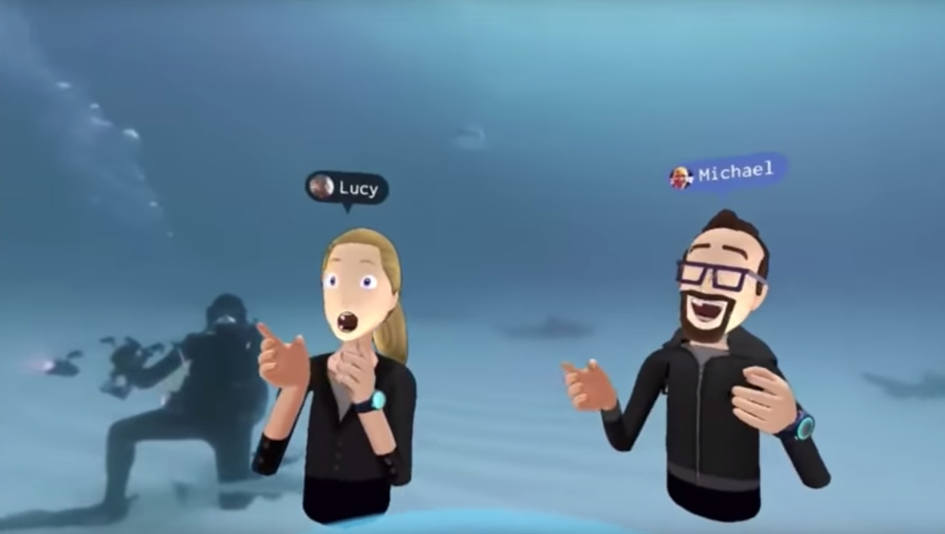
Analyse several current issues in games
VR
Sounds like a rich ecosystem for success, is it?
Oculus management team moved on from FB
Sony closing Manchester VR studio
What is the VR killer app?

Slide 9
Analyse several current issues in games
VR
Sounds like a rich ecosystem for success, is it?
Will this be the killer app?

Slide 10
Analyse several current issues in games
VR
What can history tell us about VR 1.0 (1970-90)
A period of massive growth in h/w performance
VR was technically possible
Large companies (Nintendo, Sega) developed systems
Arcade systems (Virtuality)
Generally regarded as a failure

Slide 11
Analyse several current issues in games
VR
What can history tell us about VR 1.0 (1970-90)
At the time:
Price
Discomfort
Games not worth playing

Slide 12
Analyse several current issues in games
VR
What can history tell us about VR 1.0 (1970-90)
What do we reflect on VR1.0s failure
Hardware wasn’t good enough
Headsets were bulky
VR2.0
Much better technology
Less headset bulk
Better gfx

Slide 13
Analyse several current issues in games
VR
What can history tell us about VR 1.0 (1970-90)
What do we reflect on VR1.0s failure
Hardware wasn’t good enough
Headsets were bulky
VR2.0
Much better technology
Less headset bulk
Better gfx
Still no killer app …
Is hubris at play?

Slide 14
Analyse several current issues in games
VR
Two questions:
Are killer apps key to h/w (platform) success?
Can h/w companies make killer apps?

Slide 15
Analyse several current issues in games
VR
Are killer apps key to h/w (platform) success?
Sega Saturn launched with Virtua Fighter
PS1 launched with Ridge Racer, Wipeout & Destruction Derby
N64 launched with Super Mario 64 & Pilot WIngs
GameCube launched with Luigi’s Mansion, Super Monkey Ball & Wave Race
Dreamcast: Sonic Adventure, Virtua Fighter 3, Soulcalibur
PS2 ?
Xbox: Halo, DoA3, Tony Hawk’s, Project Gotham

Slide 16
Analyse several current issues in games
VR
Are killer apps key to h/w (platform) success?
PS4
Angry Birds Star Wars, Assassin's Creed IV: Black Flag, Battlefield 4, Blacklight: Retribution (Beta), Call of Duty: Ghosts, Contrast ,DC Universe Online, DiveKick, FIFA 14, Flower, Injustice: Gods Among Us Ultimate Edition, Just Dance 2014, Killzone Shadow Fall, Knack ,LEGO: Marvel Super Heroes, Madden NFL, NBA 2K14, NBA Live, Need for Speed: Rivals, PlayRoom, Resogun, Skylanders Swap Force, Sound Shapes, Super Motherload, Trine 2: The Complete Story,Warframe

Slide 17
Analyse several current issues in games
VR
Are killer apps key to h/w (platform) success?
Xbone
Assassin’s Creed IV: Black Flag, Battlefield 4, Call of Duty: Ghosts,Crimson Dragon, Dead Rising 3, FIFA 14, Fighter Within, Forza Motorsport 5, Just Dance 2014, Killer Instinct, Lego Marvel Super Heroes, LocoCycle, Madeen NFL 25, NBA 2K14, NBA Live 14, Need for Speed: Rivals, Peggle 2, Powerstar Golf, Ryse: Son of Rome, Skylanders: Swap Force, Watch Dogs, Zoo Tycoon ,Zumba Fitness: World Party
(spot the similarities)

Slide 18
Analyse several current issues in games
VR
Are killer apps key to h/w (platform) success?
Having a good launch roster wont make your h/w a success
Not having a good launch roster (or a stream of quality games) will make it fail
Dreamcast – EA wouldn’t support it
Gamecube – so little content that large box shifters cleared it from inventory
PSP / PS Vita – never seemed to have anything that would make you buy it
I only got mine for the developer studio

Slide 19
Analyse several current issues in games
VR
Can h/w companies make killer apps?
Should h/w companies buy or build their apps?
Sony
Generally, all their ‘good’ games have come from:
3rd parties
Digital Polophony
1st parties that were 3rd parties
Media Molecule, Guerilla, Insomniac, Naughty Dog
Sony London
Have made very impressive casual games (singstar, eyeToy, eyePet)
Are these killer apps for a new platform?

Slide 20
Analyse several current issues in games
VR
Can h/w companies make killer apps?
Generally, the culture of h/w companies does not lend itself to s/w development
Google Android
Google writes O/S
Vendors build hardware
(generally) vendor extended O/S are a bit lacklustre
Microsoft
(Generally) doesn’t build h/w
Acquired Nokia, results weren’t good
Apple
An exception to this rule? Pioneered AppStore for phones

Slide 21
Analyse several current issues in games
VR
What does history tell us?
To make products and services that work, there has to be a customer need, even if customers are not aware of this.
See this with all architectural and radical innovation as they are about creating new markets
Record player -> I wasn’t aware I needed to listen to music I like
Cassette recorder -> I wasn’t aware I needed to record music I like
Walkman -> I wasn’t aware I needed to listen to music on my own
iPod -> I wasn’t aware I needed all my music in my pocket
Spotify -> I wasn’t aware I needed to be able to stream all the music ever (that we have licenced)

Slide 22
Analyse several current issues in games
VR
What does history tell us?
To make products and services that work, there has to be a customer need, even if customers are not aware of this.
The prospect of buying h/w with nothing (or rubbish games) to play on it, isn’t exactly appealing
Sony, MS & Nintendo understand this with their console launch game rosters

Slide 23
Analyse several current issues in games
VR
So why is VR different
Companies general reluctant to develop ‘open’ apps for other systems (VR or otherwise)
Look at the walled gardens with mobile phone contracts
PSVR is a walled garden
Buying in expertise
Where is the expertise?
Building expertise is likely to be cheaper / less risky
Organisational culture may not lead to desirable results
Do we even know what successful VR is?

Slide 24
Analyse several current issues in games
VR
Conclusion
VR is very different to what has come before
Developers likely to struggle until the ‘rules’ of development become more apparent
Are there historical precedents for this?

Slide 25
Analyse several current issues in games
VR
Revolutionary times

Slide 26
Analyse several current issues in games
Maturing markets, products and models

Slide 27
Analyse several current issues in games
Maturing markets, products and models
The 21st century has seen games becoming huge global brands
Mario – 1BN
Call of Duty -300M
GTA – 300M
FIFA – 250M
The Sims -200M
Minecraft – 176M
Assassin’s Creed - 140M
Lego – 100M
Halo – 70M
Monster Hunter – 60M
Counter-Strike – 50M

Slide 28
Analyse several current issues in games
Maturing markets, products and models
The 21st century has seen games becoming huge global brands
Anecdotally, the games industry is ‘risk adverse’
Unwilling to commit large amounts of resources to novel projects
Lots of failures out there:
Lawbreakers
Spore
‘Pareto analysis’ – 20% of a publisher’s game roster will make 80% of the profit

Slide 29
Analyse several current issues in games
Maturing markets, products and models
The 21st century has seen games becoming huge global brands
Anecdotally, the games industry is ‘risk adverse’
Unwilling to commit large amounts of resources to novel projects
This isn’t universal, but
Publishers probably happier to develop GTA6 rather than Dreams

Slide 30
Analyse several current issues in games
Maturing markets, products and models
The 21st century has seen games becoming huge global brands
See this in other entertainment industries
Movies
Reliance on ‘Harry Potter’, ‘super hero’ & ‘Star Wars’ brands & franchises
Sequelitis
Novel IP often difficult to deliver vs. ‘art-house’
A lot of interest in remaking existing IP for C21st audience
Repurposed Existing IP often struggles (Cats)

Slide 31
Analyse several current issues in games
Maturing markets, products and models
The 21st century has seen games becoming huge global brands
See this in other entertainment industries
Music
Reliance on stadium friendly touring megastars
Difficulties for grass-roots bands & venues
Search for me-too music
Manufactured and packaged music
Sell out of underground music genres

Slide 32
Analyse several current issues in games
Maturing markets, products and models
The 21st century has seen games becoming huge global brands
See this in other entertainment industries
Football / Sport
Reliance on global brands (Euro Premier teams)
Cricket personalities playing franchised 20-20

Slide 33
Analyse several current issues in games
Maturing markets, products and models
What can history tell us about this strategy?
‘Innovator’s dilemma’ – Christensen
Ground-breaking research into technology driven innovation from 1970s
Disruptive technologies allow start-ups to displace incumbent (market leaders)
Start-ups then become incumbent
Incumbents can’t change strategy as quickly as start-ups
A dog eat dog model

Slide 34
Analyse several current issues in games
Maturing markets, products and models
What can history tell us about this strategy?
‘Innovator’s dilemma’ – Christensen
This is about more than just hard drives ;)
Market leaders have trouble changing direction quickly due to inertia (aka super tanker analogy)
Start-ups don’t, cost of risk is relatively low (pivot / sharp bend)
Can experiment
Successfully disrupting can destroy the existing market & incumbents

Slide 35
Analyse several current issues in games
Maturing markets, products and models
What can history tell us about this strategy?
Examples:
Sony Walkman
Created the personal stereo market in 1979
Walkman entered the dictionary
Responsible for increases in walking as exercise
Apple iPod
Created in 2001, ‘all your music in your pocket’
Destroyed the Walkman as a device and cassette tape as a medium

Slide 36
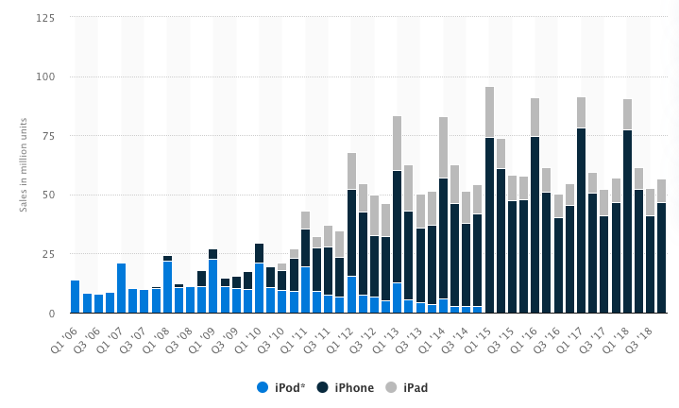
Analyse several current issues in games
Maturing markets, products and models
What can history tell us about this strategy?
Examples:
Apple iPhone & Android Phones
Launched from 2007 onwards
Largely destroyed the iPod market
Good for Apple, iPhone & iPad sales dwarfed iPod

Slide 37
Analyse several current issues in games
Maturing markets, products and models
What can history tell us about this strategy?
Examples:
Music streaming: Spotify et al
Launched from 2011 onwards
Reducing need to ‘own’ music

Slide 38
Analyse several current issues in games
Maturing markets, products and models
Warcraft
Unbeatable from 2007-2015
Survived many attempts to take userbase (SW MMO)
Now, under ‘attack’ from newer game services
Fortnite, Rust, PUBG etc
[Notice how much more difficult it is to get game industry data]

Slide 39
Analyse several current issues in games
Maturing markets, products and models
Conclusions
Nothing lasts for forever
So, make hay while the sun shines
GTA5 online play (maybe cheaper to support than developing GTA6)
How can companies innovate while they are successful
Christensen suggests this is v. difficult (for firms that have grown quickly from start-ups)
Need to be prepared to kill your golden goose
Apple ipod -> iphone -> ipad
Hello games Joe Danger -> NMS

Slide 40
Analyse several current issues in games
Maturing markets, products and models
Conclusions
Failure is always an option
AppleTV, Google Glass
Limited success is always an option too
Apple Watch

Slide 41
Analyse several current issues in games
Maturing markets, products and models
Conclusions
Does an organisation have deep enough pockets to run with its limited successes or kill its failures
Apple -> keeps AppleTV going, pushing Watch
Hello Games -> Massive early revenues from NMS allowed the company to re-tool the game to fit expectations
Many companies just don’t have the resources or attitude to risk to do this
Publishers often shutter and move on

Slide 42
Analyse several current issues in games
Maturing markets, products and models
Conclusions
The vast bulk of novel development will be occurring in secret
Games industry is notorious for keeping quiet
‘Killer apps’ may not even be in development, or known by publishers
A lot of games will get pitched rather than developed in-house
Christensen’s start-up culture of move fast, take risks & break things

Slide 43
How does this tie into your assignment

Slide 44
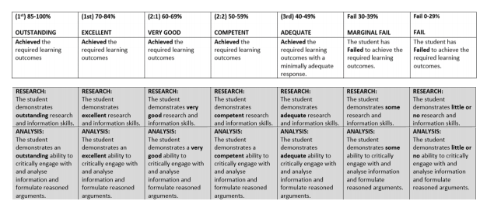
How does this tie into your assignment
Let’s go back to the rubric

Slide 45
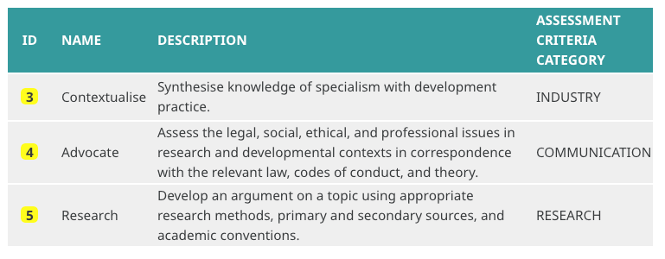
How does this tie into your assignment
Let’s go back to learning space

Slide 46
How does this tie into your assignment
Analyse
Need to have a ‘so what’ moment in your writing
Otherwise it’s just description / narrative
E.g.
Reliance on ‘Harry Potter’, ‘super hero’ & ‘Star Wars’ brands & franchises
Novel IP often difficult to deliver vs. ‘art-house’
Existing IP often struggles (Cats)
(Analysis bit) This means that …

Slide 47
How does this tie into your assignment
Structuring research
[This is dedicated to everyone that used a reflective framework for GAM320]
Analytical frameworks can be very useful for organising your thoughts and developing / seeing arguments
Particularly from multiple perspectives (stakeholders)

Slide 48
How does this tie into your assignment
Structuring research
An Innovation framework
Architectural
Radical
New
Markets
Incremental
Disruptive
Existing
Existing
Technology
New

Slide 49
How does this tie into your assignment
Structuring research
An Innovation framework (Sony)
Architectural
PSP / Vita / PS Go
Moving PS-concept to portable & mobile platforms
Radical PS1
redefined what consoles were and made them acceptable to new players (markets)
New
Markets
Incremental slim(s)
Process improvement to cost-reduce h/w
Disruptive PS2, PS3, PS4
new iterations of PS with ‘new & improved tech’
Existing
Technology
Existing
New

Slide 50
How does this tie into your assignment
Structuring research / Advocate
Drivers of change (STEP, PEST, PESTLE, STEEPL)
Driver | Definition
Societal | What does society (or a group / market) ‘want’ (Ford’s ‘faster horses’) or ‘need’
Technological | What technology is available to create novel (innovative) products and services
Economic | What are the financial constraints or enablers
Political | What is the political (small-p) power / relationships of stakeholders
Legal | What are the legal constraints or enablers
Environmental | What are the environmental constraints or enablers (this may lag legal)

Slide 51
Conclusions

Slide 52
Conclusions
There’s generally nothing new under the sun
Most of what people & organisations are doing has been done in some shape, manner or form before
History can help us to see what the outcomes and issues are likely to be
We can learn from that (and make new mistakes)
We can ignore that and make the same mistakes (and make new mistakes)
Beware of:
Historical bias (survivor / success & simplicity biases)
Present bias (hubris)
Future bias (outcome)

Slide 53
Conclusions
Models & frameworks will help you with your research
Structure your research activities
Write your reports

Slide 54
Conclusions
Good luck with your assignments!

Slide 55
Do you have any questions for me?

